Slide 1
Making Payments to Foreign Persons

Slide 2
What is a Foreign Person?
Any person or entity that is not either:
A U.S. Citizen,
A Permanent Resident (“Green Card” Holder),
A Tax Resident, or
A legal entity (company, university, library, etc.) located and registered within the U.S.
Common Foreign payments that are made include visiting scholars, BYU students, and payments to foreign entities such as royalties.

Slide 3
What is Sourced to the U.S.?
Type of Income | Where Sourced
Services—including Independent Contractors, Honorariums, and Stipends | Where the services are performed
Royalties—including Licenses and User Fees | Where the property (tangible or intangible) is used
Scholarships | Where the payer is located
Awards and Prizes | If either event or payer is within the U.S., the award/prize is sourced to the U.S.

Slide 4
What is NOT Sourced to the U.S.?
Purchasing tangible goods from abroad
For example, buying an actual book that is then shipped to you in the U.S.
Paying for services rendered outside the U.S.
For example, paying a tour guide or for hotel lodging on a study abroad trip

Slide 5
How Much Is Withheld?
Before considering possible tax treaties:
30% of most payments
14% of scholarships in excess of tuition, books, and required fees
Often times some or all of the withholding is refunded if/when the payee files a U.S. return

Slide 6
What if We Fail to Withhold?
Withholding rates vary from 10% to 30% depending on the type of income and tax treaty provisions
BYU is liable for the tax that should have been withheld
Even if it would have been refunded
BYU is also liable for penalties and interest
Up to 25% of the amount that was not withheld

Slide 7
Claiming Tax Treaties
If treaty benefits are to be claimed, the forms require a U.S. Taxpayer Identification Number
Process may take 6 – 8 weeks in many cases

Slide 8
Foreign Citizen/Entity Payments
http://home.byu.edu/webapp/finserve/content/page/Tax_Matters_Foreign_Citizen_Entity_Payments.html

Slide 9
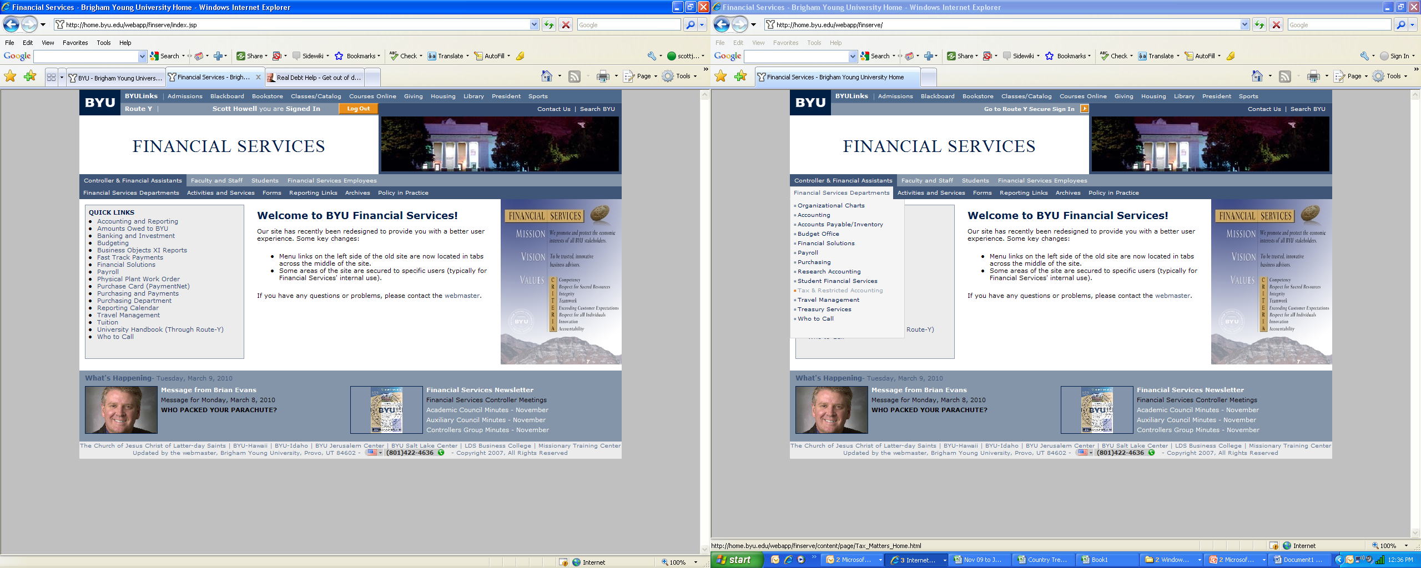

Slide 10
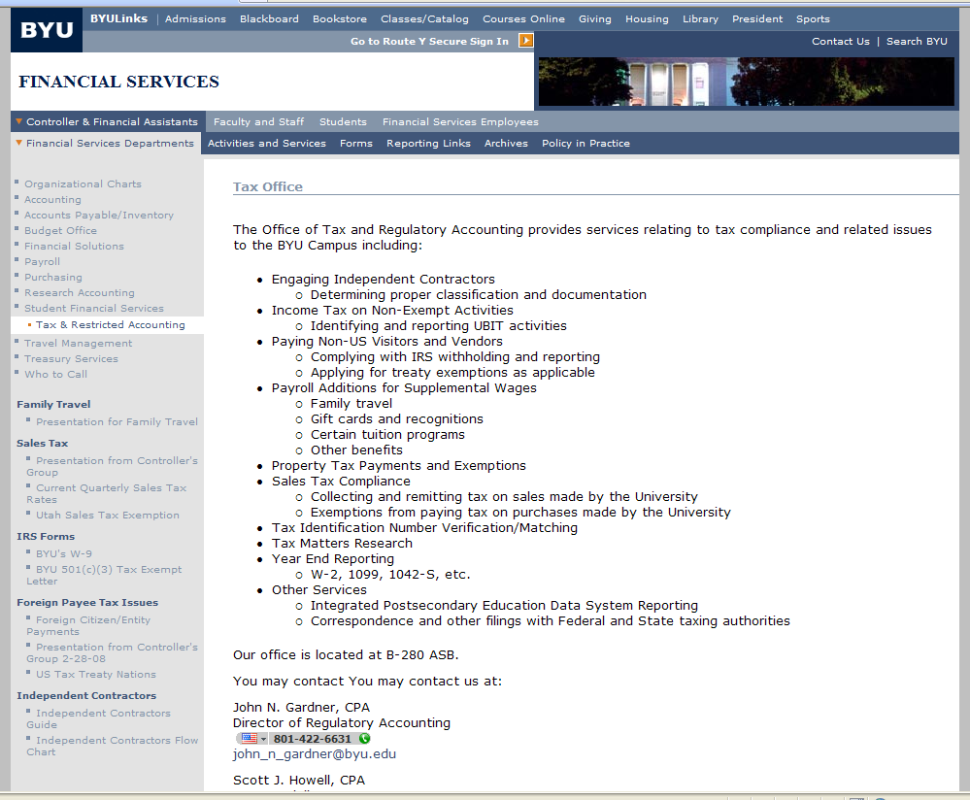

Slide 11
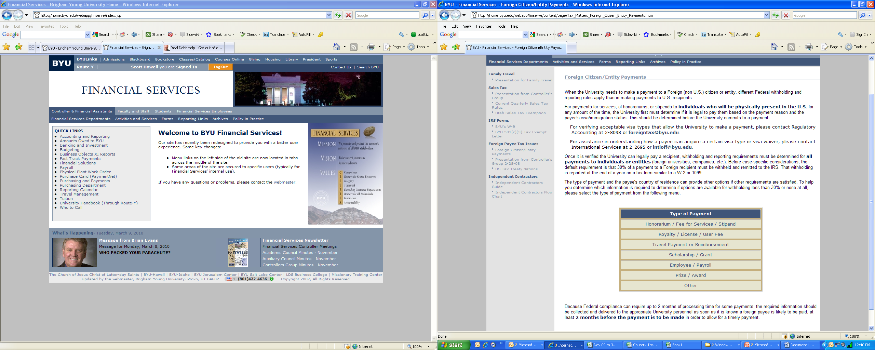

Slide 12
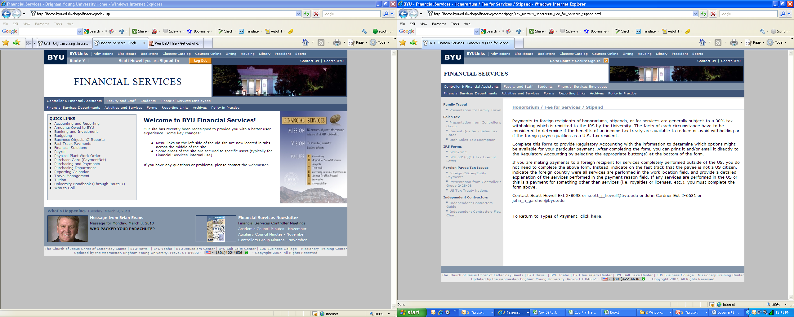

Slide 13
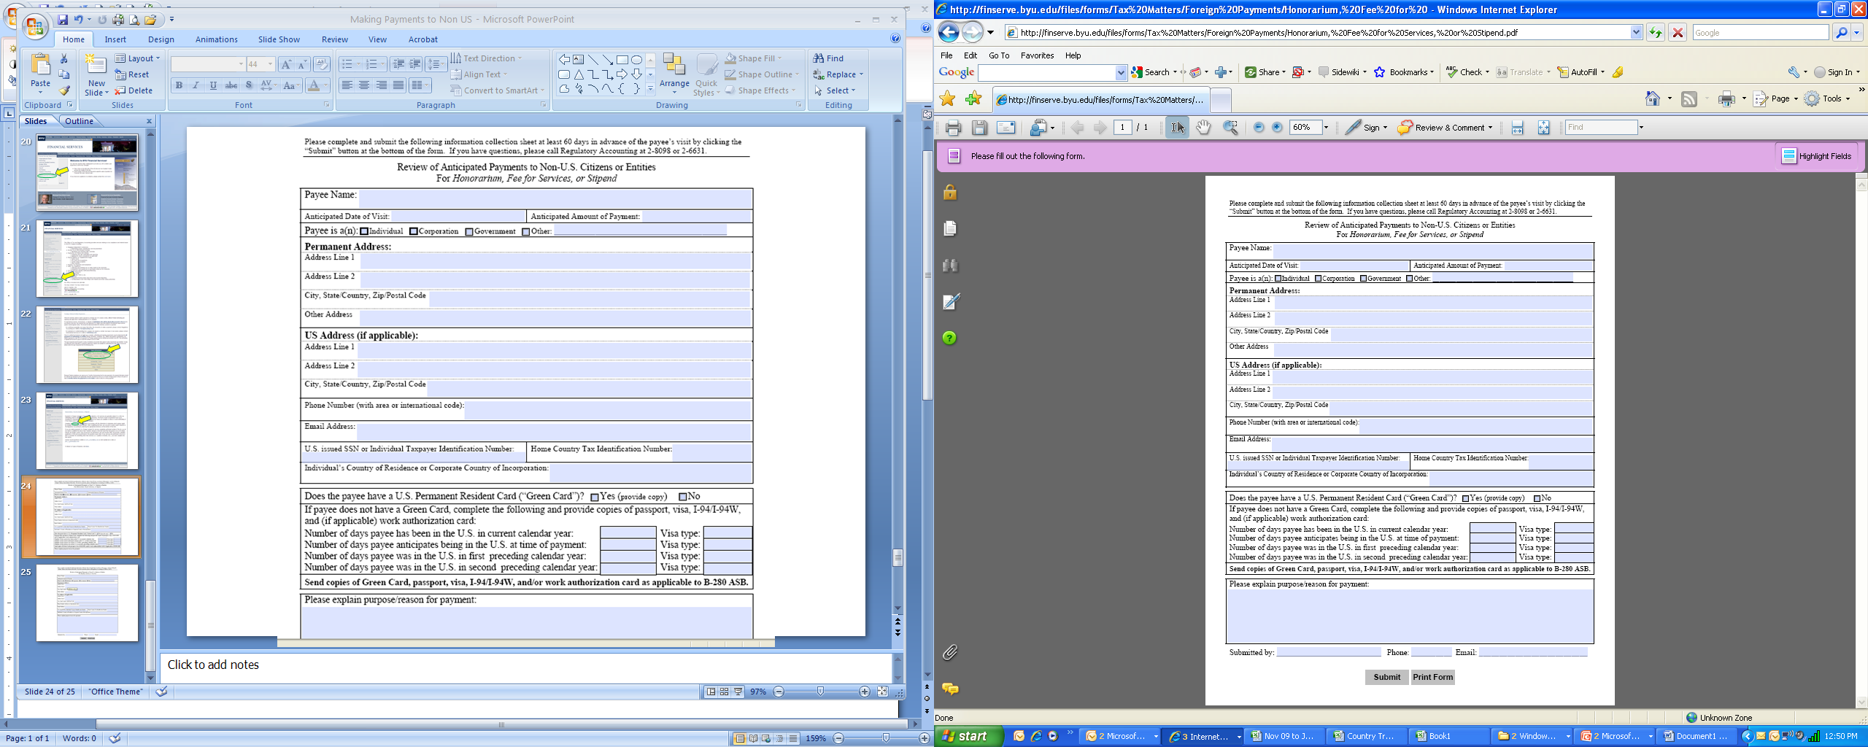

Slide 14
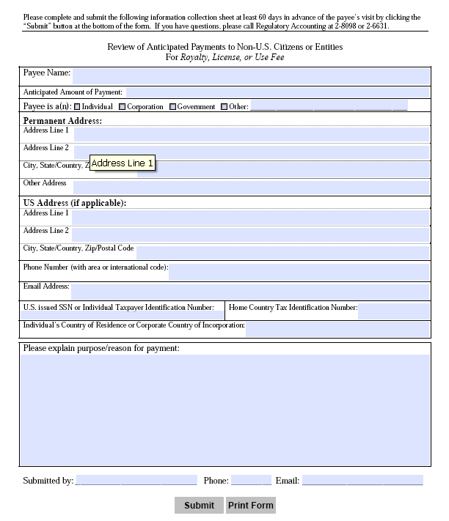

Slide 15
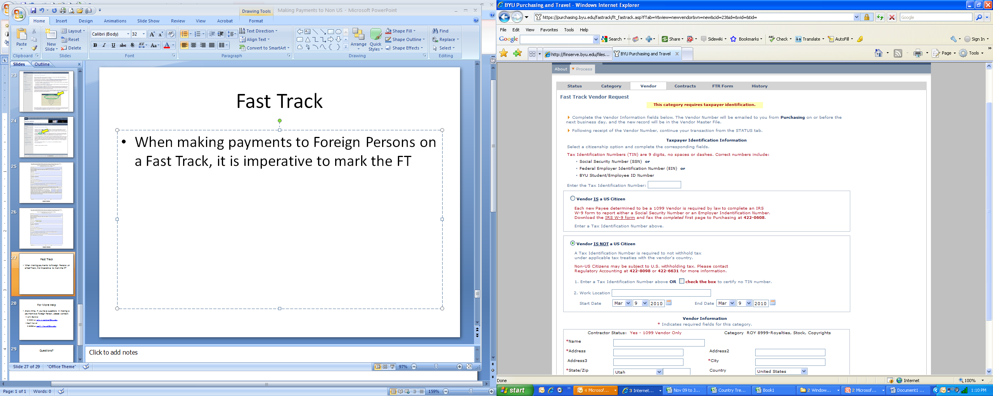
Fast Track
When making payments to Foreign Persons on a Fast Track, mark the FT as no a U.S. Citizen

Slide 16
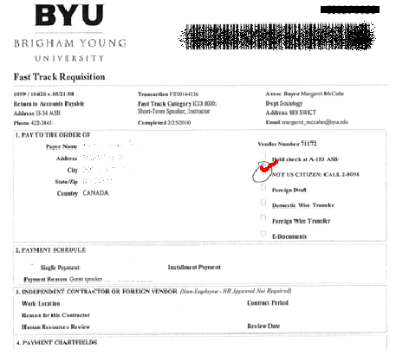
Fast Track
Verify the printed FT is also marked

Slide 17
For More Help
At any time, if you have questions in making a payment to a Foreign Person, please contact:
John Gardner
2-6631 or john_n_gardner@byu.edu
Scott Howell
2-8098 or scott_j_howell@byu.edu

Slide 18
Questions?

